Slide 1
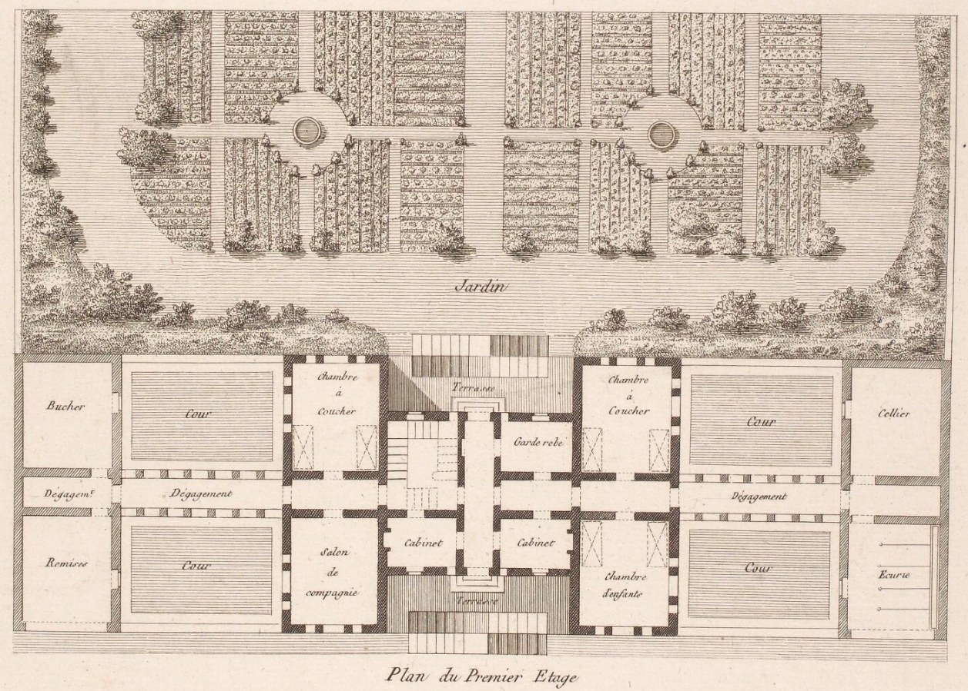
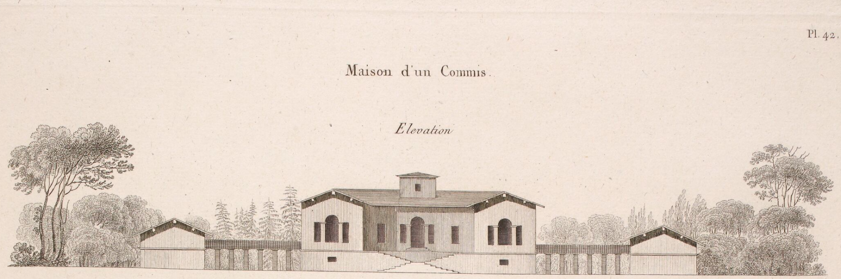
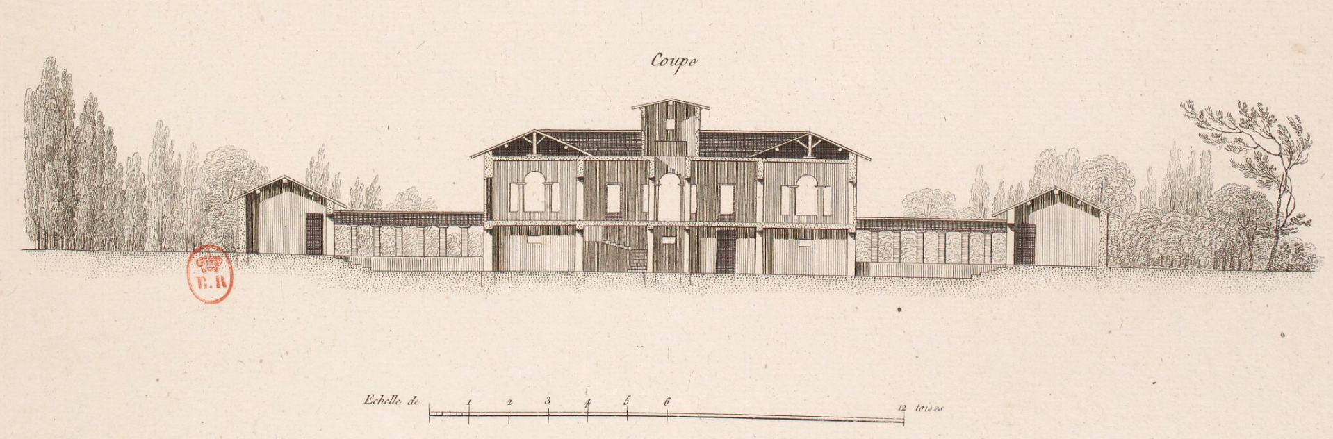
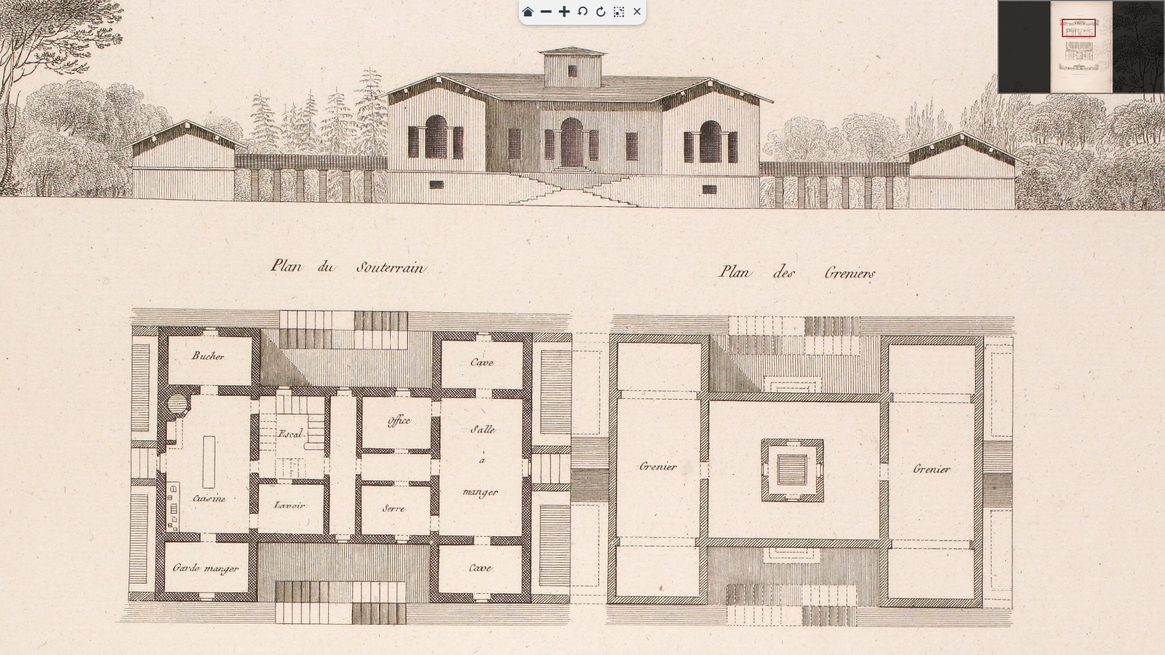
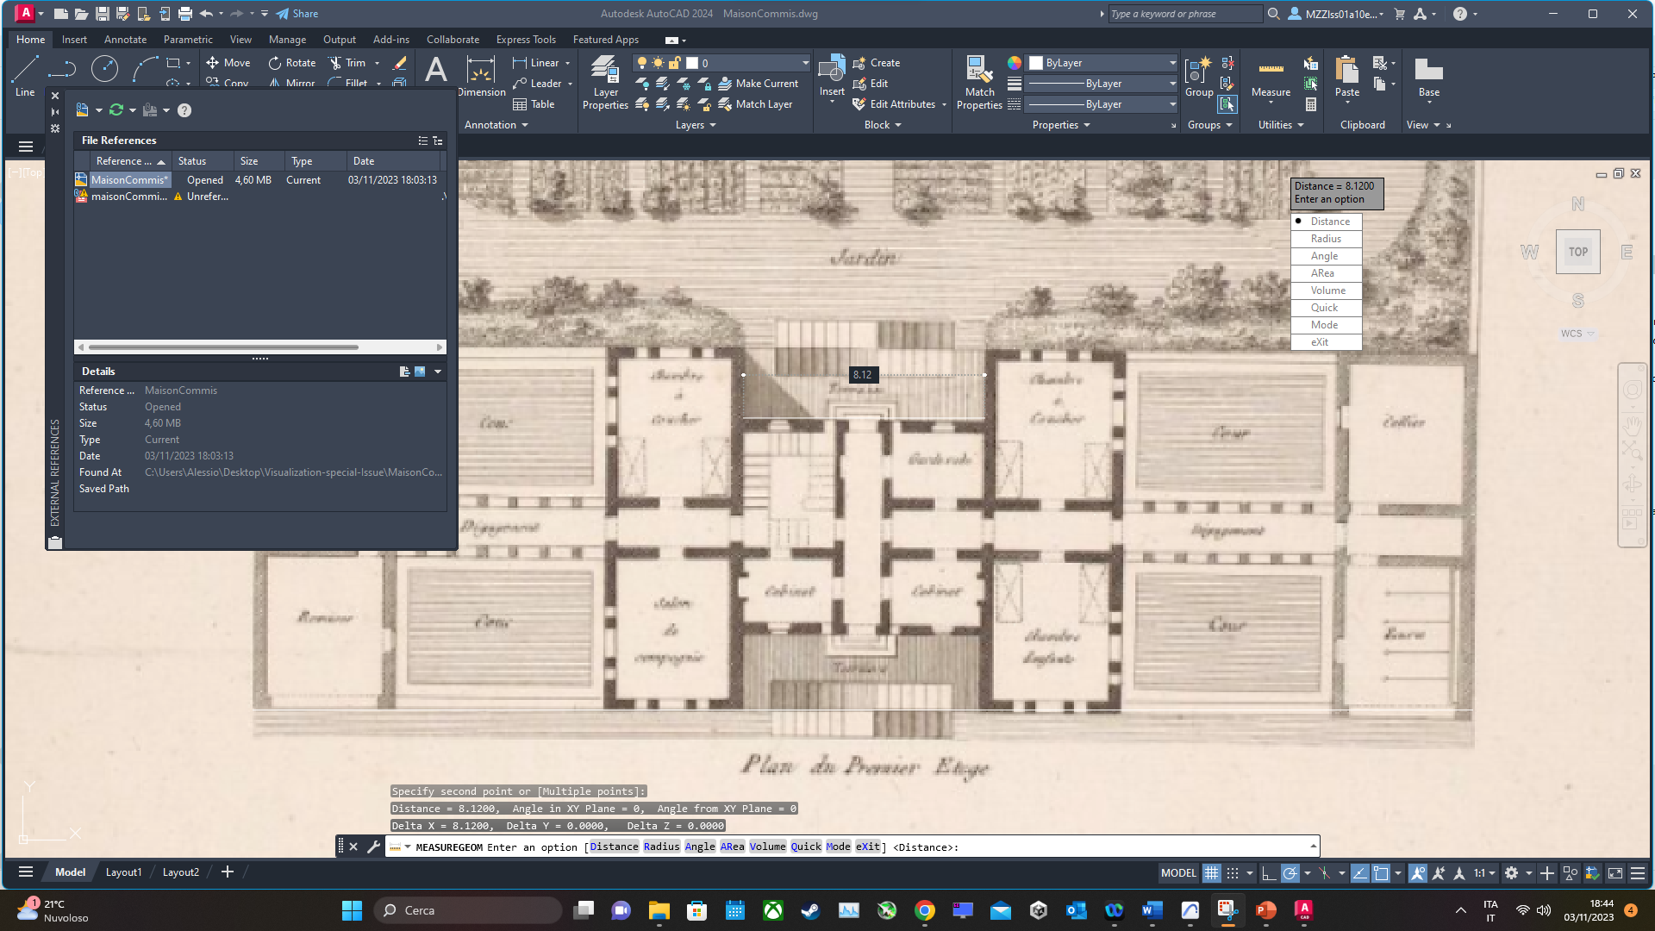
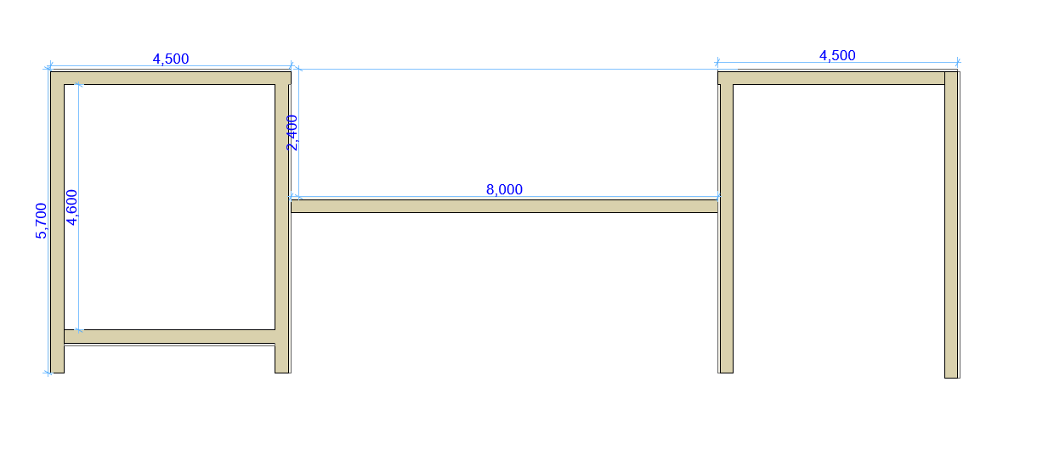
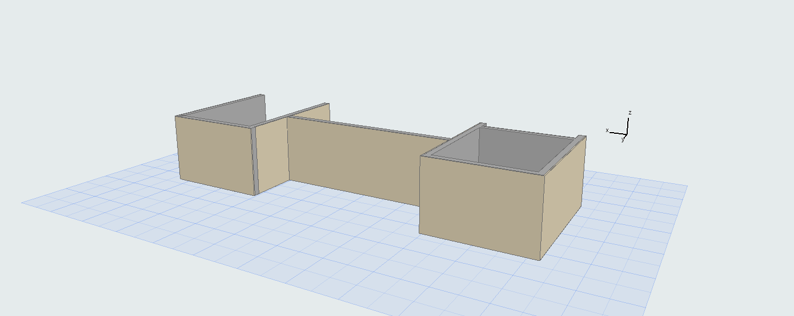



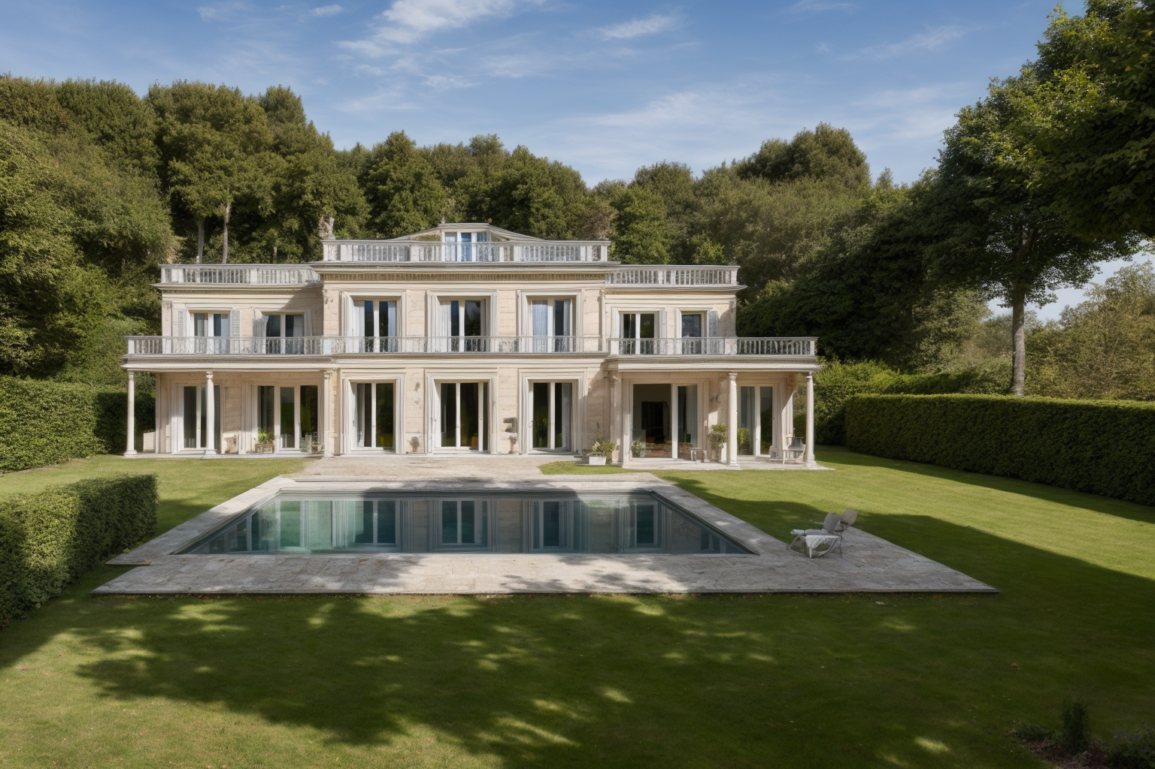
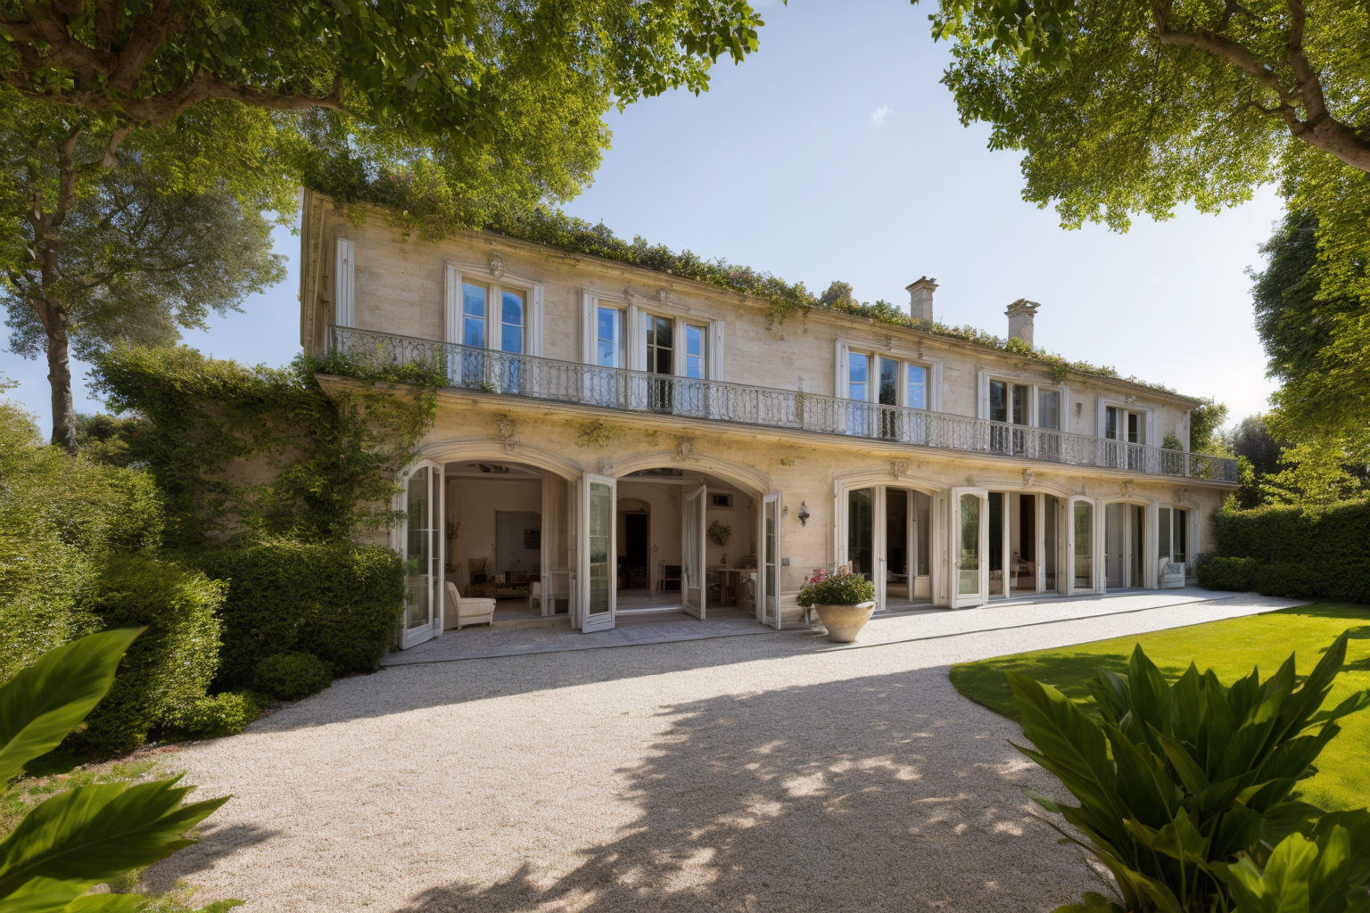
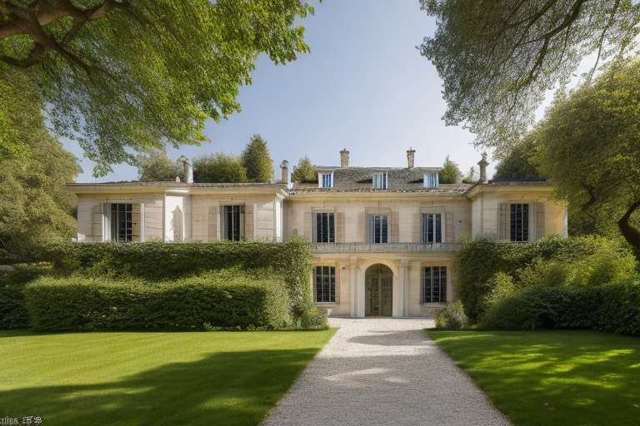
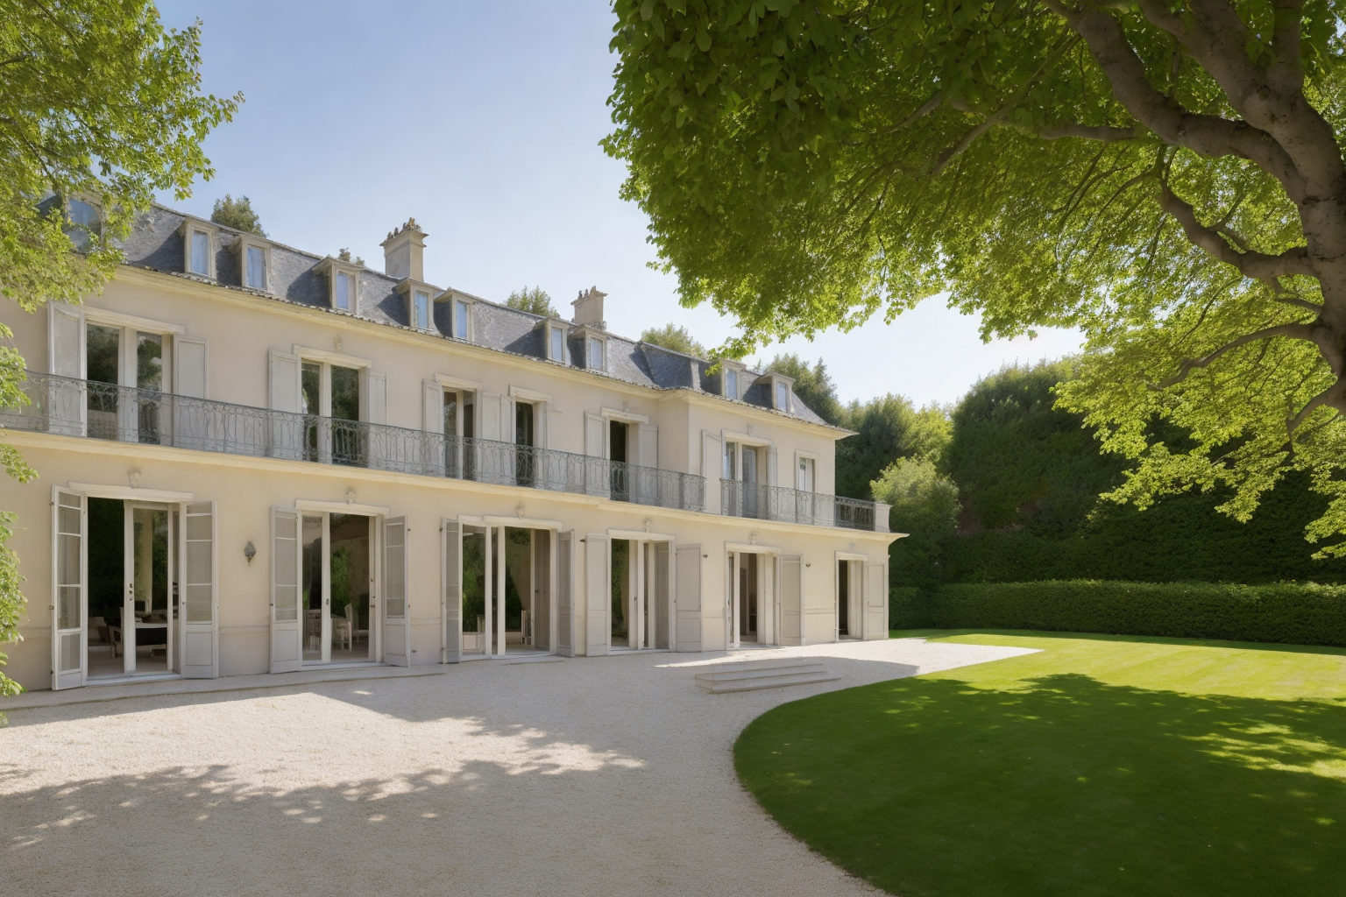
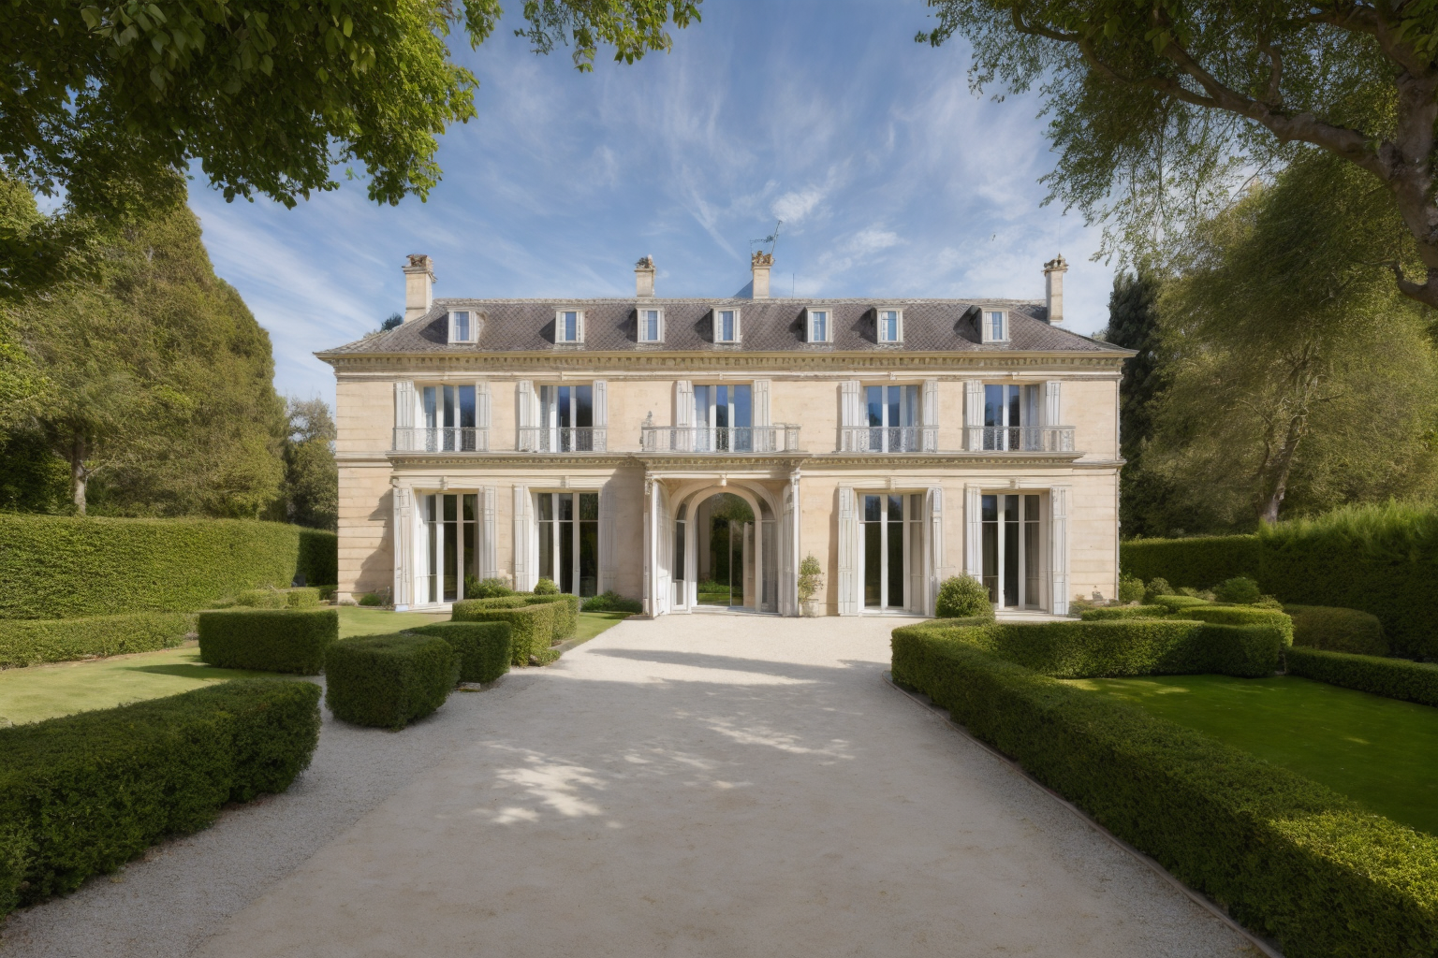
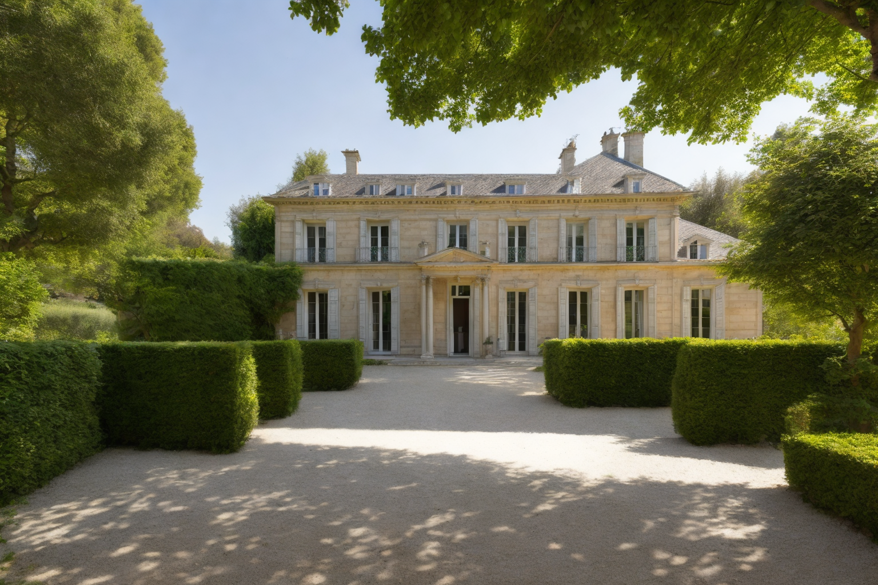
Assignment 09.11.23 Objective: Develop an initial presentation draft in portrait A1 format for the semester's project.
Maison d'un Commis, “Planche 42”
"Maison d'un Commis" translates to "House of a Clerk" in English, is a particular project is known for its unique and innovative architectural design especially in terms of its practical and functional aspects.
During the 3D modeling process an emphasis should also be placed on the garden, which could prove to be a particularly intriguing modeling subject.
Geometries and Exterior
From a geometric and external space perspective is the remarkable symmetry, which warrants in-depth analysis both in terms of aesthetics and functionality:
In terms of geometry, the house exhibits a highly symmetrical appearance, that makes this house particularly intriguing, and, when it comes to the
external spaces, 'Maison d'un Commis' stands out as a very captivating project.
It demonstrates how the garden is seamlessly integrated as an integral part of the house
Semester Project: The project entails the creation of a 3D model suitable for integration into Unity as an asset. This model is expected to encompass various elements, including the representation of the surrounding environment, lighting, external spaces, and internal spaces.
High resolution initial sketches, taken from https://gallica.bnf.fr/ark:/12148/bpt6k1047050b/f333.item
3D Modelling Process (Still getting confident with software)
1. Gathering Precise Measurements
First, I'll start by gathering precise measurements using AutoCAD. This step is crucial to ensure that I have accurate and detailed data about the physical space I'm working with. AutoCAD will be my tool for creating meticulous drawings and plans that serve as the foundation for the project.
2. Detailed Modeling in ArchiCAD
With all the measurements and data at hand, I'll move on to the modeling phase in ArchiCAD. ArchiCAD is a powerful architectural design and modeling software that will enable me to create a comprehensive 3D model. This model will accurately replicate the physical space, encompassing all architectural elements with a high level of detail.
3. Asset Preparation for Unity Integration
Next, I'll prepare the 3D model from ArchiCAD for integration into Unity. In Unity, I will define my 3D model as a crucial asset for my project. This asset will not only include the architectural components but also elements like lighting and other environmental features to make the model complete and immersive.
4. In-Depth Investigation in Unity
In Unity, I'll dive into the 3D model for an in-depth investigation. Unity offers real-time interaction and visualization, allowing me to explore the model from a multitude of viewpoints. I'll meticulously assess the surrounding environment, evaluate the quality of lighting, examine external spaces, and navigate through the intricacies of internal spaces, all within the Unity platform.
5. Comprehensive Analysis and Refinement
During my investigation in Unity, I'll conduct a comprehensive analysis of the model. This involves looking for areas that can be improved and optimizing the overall performance. I'll also ensure that the model aligns seamlessly with the project's objectives. This might include refining intricate details, experimenting with various lighting effects, and evaluating user interactions to enhance the overall experience.
comprehensive and interactive 3D model of my project. This approach leverages the capabilities of AutoCAD, ArchiCAD, and Unity to develop a virtual representation that can be explored and analyzed from various perspectives, ultimately contributing to an effective and successful project development and assessment."
Extras: 3D model (from a point of view of materials) AI Generated Images with Stable diffusion

